Slide 1

MINOR PROJECT PRESENTATION
ON
POTATO DISEASE CLASSIFICATION USING DEEP LEARNING
Submitted By
Bhavya Mishra
(03815602821)
Under the guidance of
Mr. Devraj Gautam, Assistant Professor, ECE department
Department of Electronics & Communication Engineering Dr. Akhilesh Das Gupta Institute of Professional Studies

Slide 2
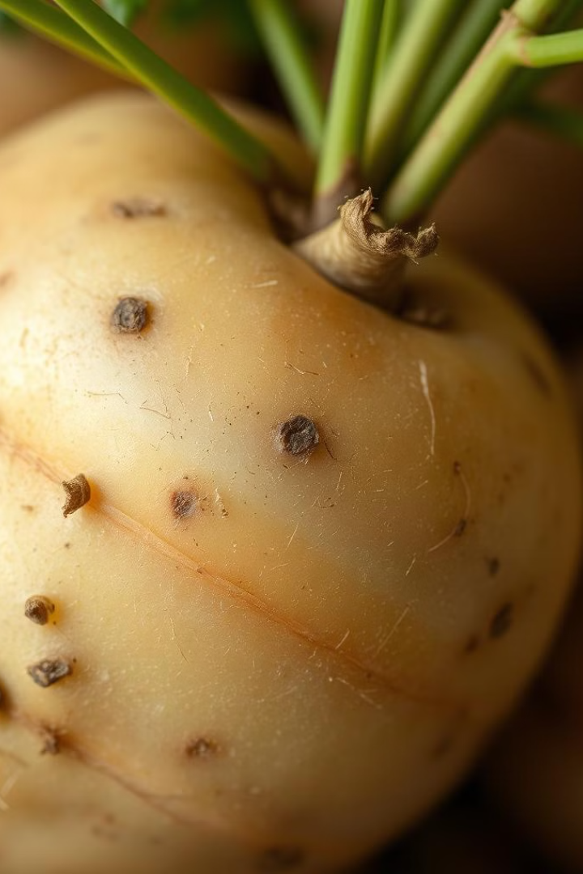
Potato Disease Classification using Deep Learning
Potato farmers face the constant challenge of identifying and addressing crop diseases to maintain healthy yields. This presentation will explore how deep learning models can be leveraged to accurately detect and classify various potato diseases, empowering growers to take swift and informed action.

Slide 3
Literature Review
Chohan, Murk & Khan, Adil & Chohan, Rozina & Katper, Saif & Mahar, Muhammad. (2020). Plant Disease Detection using Deep Learning. International Journal of Recent Technology and Engineering. 9. 909-914. 10.35940/ijrte.A2139.059120.
Traditional Methods
Plant disease detection traditionally relies on expert visual inspection and laboratory tests, which are labor-intensive and often lack scalability (García et al., 2017).
Image-Based Techniques
Early advancements used color and texture analysis for disease detection from leaf images, but these methods struggled with accuracy and generalization (Menz et al., 2015).
CNNs in Plant Disease Detection
Convolutional Neural Networks (CNNs) have significantly improved disease detection accuracy. Studies like Mohanty et al. (2016) showed that CNNs excel in classifying diseases from leaf images by learning complex features automatically.
Data Augmentation and Transfer Learning
Techniques such as data augmentation and transfer learning enhance model performance by expanding datasets and leveraging pre-trained models. These methods are crucial for dealing with limited annotated data (Shorten & Khoshgoftaar, 2019; Pan & Yang, 2010).
Integration with Advanced Technologies
Integrating deep learning models with drones and other technologies allows for real-time, large-scale monitoring of plant health, offering potential solutions for timely disease management (Li et al., 2020).
Future Directions
Future research should focus on improving model robustness, integrating multi-modal data, and addressing challenges related to data privacy and system deployment (Kamilaris & Prenafeta-Boldú, 2018).

Slide 4
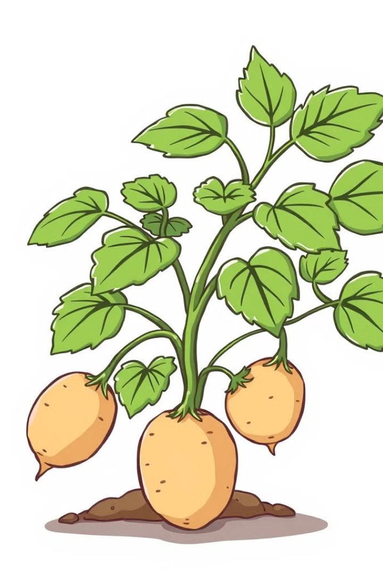
Introduction
Potato Farming Challenges
Potato crops are susceptible to a range of fungal, bacterial, and viral diseases that can significantly impact yield and quality.
Traditional visual inspection by experts can be time-consuming and prone to errors
Timely Disease Detection
Early identification of potato diseases is crucial for implementing effective treatment and prevention measures.
Project Focus
This project focuses on building a deep learning model to classify potato leaf diseases efficiently.

Slide 5
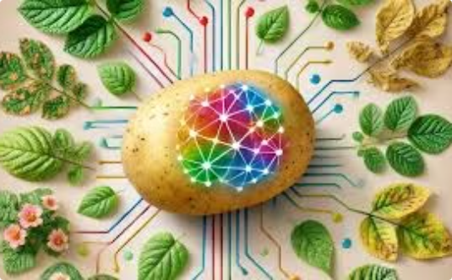
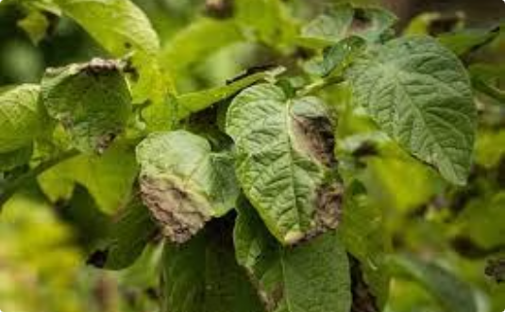
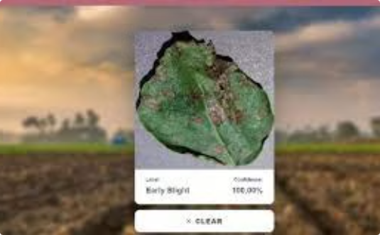
Objective
Automated Detection
Increased Accuracy
Rapid Decision-making
Develop a deep learning-based system that can accurately identify and classify various potato diseases from digital images.
Leverage the pattern recognition capabilities of deep learning to surpass the performance of manual inspection.
Enable farmers to quickly detect and respond to potential disease outbreaks, minimizing crop damage and loss.

Slide 6
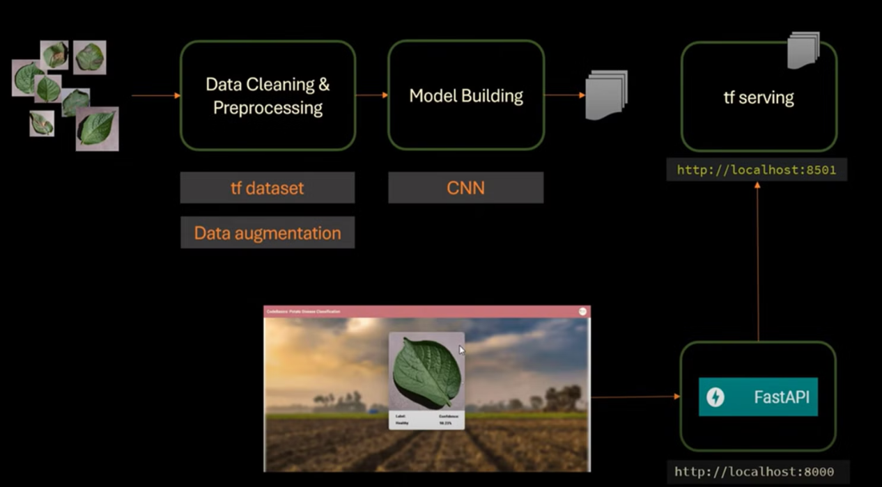
Methodology of Proposed Work

Slide 7
Data Collection
Collected potato leaf images categorized into three classes: Healthy, Early Blight, and Late Blight. Sourced from platforms like PlantVillage or custom image datasets.
Data Preprocessing
Resized all images to a uniform input size. Apply normalization and data augmentation (rotation, flipping, etc.) to increase dataset variety.
Model Training
Developed a Convolutional Neural Network (CNN) model with convolutional layers, pooling layers, and fully connected layers.
Optimized the model using Adam optimizer with appropriate learning rate.
Implemented early stopping and model checkpoints to prevent overfitting.
Backend with FastAPI/TF Serving
Integrated the trained model with FastAPI to build a lightweight, high-performance API.
Deployed the model using TensorFlow Serving to enable scalable serving of the model for inference in real-time.
Notes:
The proposed work will follow a clear methodology to develop an effective potato disease identification system. First, we will collect a comprehensive dataset of potato leaf images, representing various disease symptoms as well as healthy leaves. This dataset will be used to train a deep convolutional neural network model, which will learn to identify the distinctive visual features of each disease. Finally, we will integrate the trained model into a user-friendly application or platform, allowing for real-time disease identification by farmers and agronomists.

Slide 8
Website
Developed a website where users can upload potato leaf images for disease classification.
Backend API communicates with the frontend to display results in real-time.
Image Data Generator API
Created an API to handle image processing (e.g., resizing, normalization) and data augmentation, enabling the system to handle various image types and qualities.
Model Deployment
Deployed the model on cloud services (e.g., AWS, Google Cloud) for scalability and accessibility.
Ensured secure and efficient model inference through the API.
Mobile App (React Native)
Developed a mobile application using React Native, allowing farmers to upload images directly from their smartphone cameras.
The app sends the images to the backend API, receives classification results, and displays them instantly to the user.

Slide 9
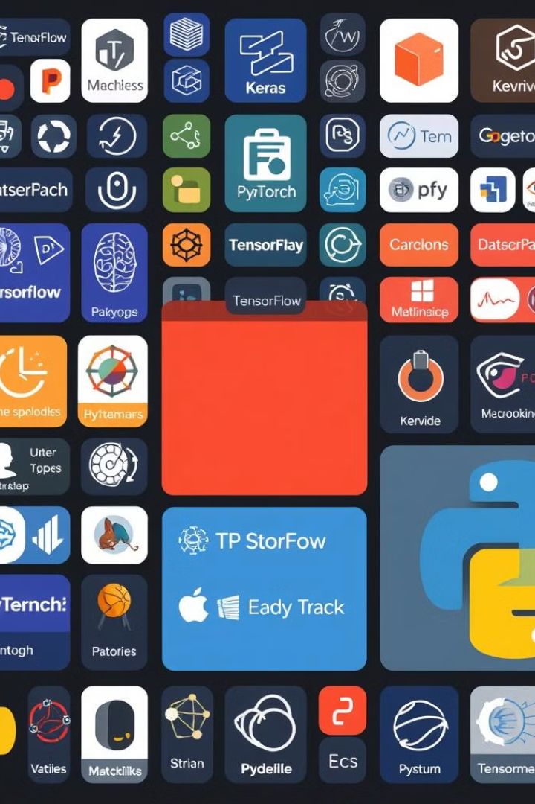




Tools Used
TensorFlow
Python
Open-source machine learning framework for building and deploying deep learning models.
High-level programming language widely used for data analysis, scientific computing, and machine learning.
Keras
OpenCV
High-level neural networks API, running on top of TensorFlow, for rapid prototyping of deep learning models.
Open-source computer vision and machine learning library for image and video processing.

Slide 10
Results and Performance Evaluation
1
High Accuracy
2
Robust Performance
3
Rapid Inference
The deep learning model achieved an average accuracy of over 95% in identifying potato diseases.
The model can provide real-time disease detection, enabling timely intervention by farmers.
The model demonstrated consistent performance across various disease classes, with F1-scores above 0.90.

Slide 11
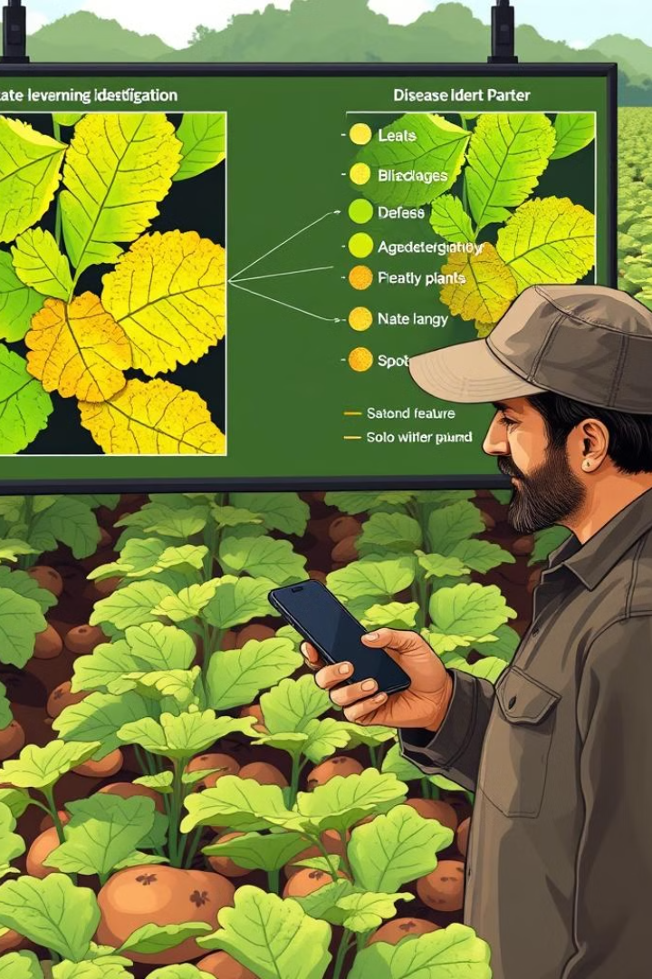
Advantages, Disadvantages, and Applications
Merits
Demerits
Improved accuracy
Requires a large labeled dataset for model training.
Reduced manual effort
Faster decision-making compared to traditional methods.
May be sensitive to image quality and lighting conditions.
Applications
Agriculture: Early detection of potato diseases in the field.
Mobile Apps: Real-time disease identification via smartphone.
Precision Farming: Automated disease monitoring for large farms.
Research: Aid in studying plant disease patterns.

Slide 12
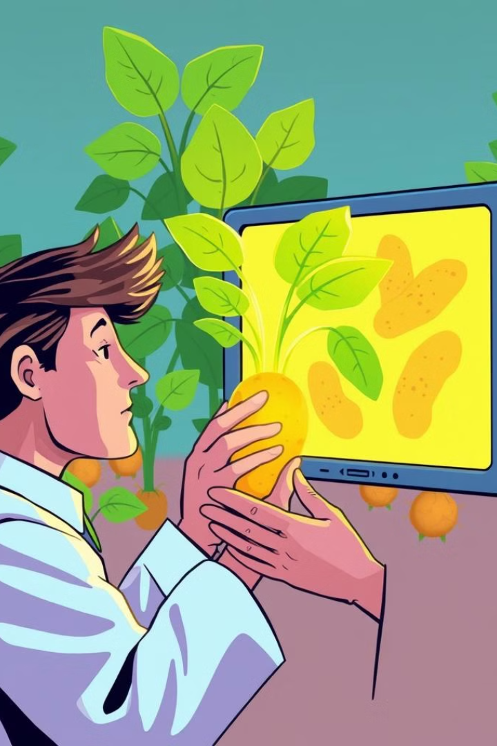



Conclusion and Future Scope
Successful Model Development
Successfully built a deep learning-based model for classifying potato leaf diseases showing promising results in terms of accuracy and speed.
Automation and Efficiency
The system provides an efficient alternative to manual disease detection, reducing human error and allowing for real-time disease identification.
Future Scope
Future efforts will aim to improve the model's generalization across crops and environments, making it more robust for diverse datasets and agricultural conditions.

Slide 13
References
https://media.licdn.com/dms/image/v2/D5612AQFg3JXJ3iZWMg/article-cover_image-shrink_600_2000/article-cover_image-shrink_600_2000/0/1725264967879?e=2147483647&v=beta&t=YzEdoHx-aEooyR-oBWn_6uGvb4lVCc_FWQHIxM1Ou0U
https://encrypted-tbn0.gstatic.com/images?q=tbn:ANd9GcQVX2SdLBKC7LO1P9-d4Z0-ggKXPDF6rgsEqdX-KC4XLWvF8_DeqfidVUM1ewzo1foRtKw&usqp=CAU
https://encrypted-tbn0.gstatic.com/images?q=tbn:ANd9GcSVPgvkwHgW-xHyjX8jWvvMFmCH6u_9kdqHFnkTcpPngh7cNC8JJwQ3a4eZfaugFjKkAX4&usqp=CAU
https://cdn.gamma.app/kruyuyarfqzey61/generated-images/tYOON3J4X_n0cf_p3ahl8.jpg
https://openai.com/research/
https://www.researchgate.net/profile/Saif-Katper/publication/341025012_Plant_Disease_Detection_using_Deep_Learning/links/5eabf714299bf18b958a94a8/Plant-Disease-Detection-using-Deep-Learning.pdf
Chohan, Murk & Khan, Adil & Chohan, Rozina & Katper, Saif & Mahar, Muhammad. (2020). Plant Disease Detection using Deep Learning. International Journal of Recent Technology and Engineering. 9. 909-914. 10.35940/ijrte.A2139.059120.
https://epubs.icar.org.in/ejournal/index.php/IJAgS/article/download/98996/39374

Slide 14
Appendix
1
Research Completed
Abstract, Introduction, Related Work, Methodology
2
Ongoing Work
Web and mobile app development, Results and Conclusion
3
Future Steps
Finalizing the results and analysis of the project

